Slide 1
Course Name: Fundamentals of Plant Pathology
Course Code: 20013600
Mr. Vikash Kumar
(Assistant Professor)

Slide 2
Course Objectives
1: Name and identify different Diseases, nature of pathogens and different strategies for management of plant diseases.
2: Outline concepts, nomenclature, classification and characters of pathogens
3: Apply different principles and methods for plant disease management.
4: Take a part in identification of diseases and marketing of relevant pesticides.
5: Conclude methods to diagnose and manage a wide range of plant diseases.

Slide 3
Reproduction and classification of plant pathogenic bacteria

Slide 4
Reproduction:
(1.) Asexual and (2.) Sexual
(1.) Asexual or vegetative reproduction of bacteria:
Two process:
i. Binary Fission: It is a process by which a single bacterial cell simply divides into two in half an hour time.
ii. Budding: It is a process by which the vegetative cell forms a lateral outgrowth and gets separated from the parent cell or may form a colony.

Slide 5
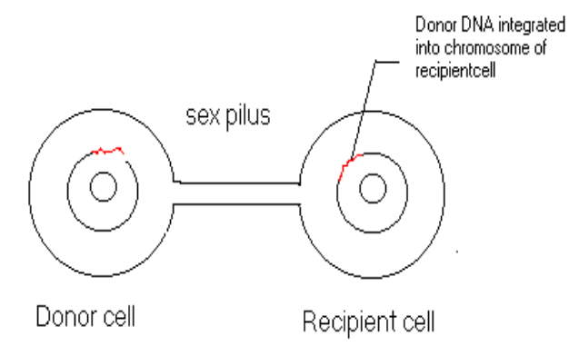
(2.) Sexual reproduction or Genetic recombination:
(1.) Conjugation:
It was discovered by Joshua Lederberg and Edward Tatum (USA) in 1946 in bacterium Escherichia coli.
It is the transfer of genetic material from a donor cell to a recipient cell through sex pilli or conjugation tube. The donor and recipient cells are sometimes referred as male and female cells, respectively.

Slide 6
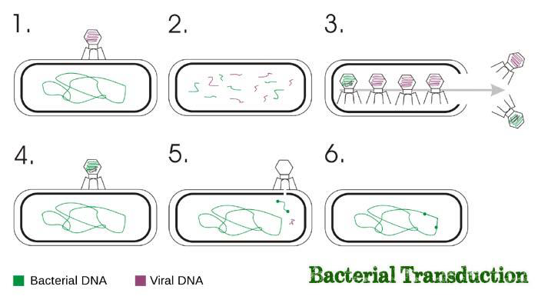
(2.) Transduction:
It was first discovered by N. Zinder and J. Lederberg in 1952, in Salmonella typhimurium, a mouse typhoid bacterium.
Transduction is the transfer of DNA from a donor cell to a recipient cell by bacteriophages. In most cases only a small segment of the host (i.e. the donor) DNA is transferred.

Slide 7
(3.) Transformation:
It was first discovered by Frederick Griffith (1928) in Pneumococcus pneumoniae.
Transformation is the gene transfer by soluble or naked DNA, which has been extracted or otherwise liberated from a donor bacterium to a recipient bacterium through diffusion.
Griffith (1928), an English bacteriologist, accidently found that the heat-killed bacteria of virulent strain (type) of Pneumococcus pneumoniae could transfer characteristics of its strain to the non-virulent strain of living bacteria.
Avery, Macleod and McCarty (1944) observed that it is due to the transfer of DNA segments from the dead cells to the living cells is called as "transformation".

Slide 8
Classification of plant pathogenic bacteria.
Present classification – 2nd edition of bergey’s manual of systematic bacteriology published in 2004, the prokaryotic organisms are divided into two domains, Archea and Bacteria, using 16 S r RNA gene sequencing.
Domain bacteria is sub-divided into 24 Phyla but plant pathogenic genera are placed in only 3 phyla.
1. Proteobacteria
2. Firmicutes
3. Actinobacteria

Slide 9
A. Phylum – Proteobacteria (Gracilicutes)
Biggest phylum containing the gram negative (-) bacteria, classified by their rRNA sequences.
1. Class – Alphaproteobacteria
i. Order – Rodospirales
Family – Acetobacteriaceae
E.g. – Acetobacter, Gluconobacter
ii. Order – Rhizobiales
Family – Rhizobiaceae
E.g. – Agrobacterium - the cause of crown gall disease
Rhizobium - the cause of root nodules in legumes

Slide 10
2. Class – Betaproteobacteria
i. Order – Burkholderiales
Family – Burkholderiaceae
E.g. – Burkholderia, Ralstonia
Family – Comanonadaceae
E.g. – Acidovorax - causing leaf spots in corn, orchids, and watermelon
3. Class – Gammaproteobacteria
i. Order – Xanthomonadales
Family – Xanthomonadaceae
E.g. – Xanthomonas - causing numerous leaf spots, fruit spots, and vascular wilts, and citrus canker
Xylella - xylem — inhabiting, causing leaf scorch and dieback diseases on trees and vines
ii. Order – Pseudomonadales
Family – Pseudomonadaceae
E.g. – Pseudomonas - causing numerous leaf spots, blights, vascular wilts, soft rots, cankers, and galls
Ralstonia - causing wilts of solanaceous crops

Slide 11
iii. Order – Enterobacteriales
Family – Enterobacteriaceae
E.g. – Erwinia - causing fire blight of pear and apple, Stewart’s wilt in corn
Pentoea - causing wilt of corn
Serratia marcescens - being a phloem-inhabiting bacterium causing yellow vine disease of cucurbits
Pectobacterium, Enterobacter, Bernnaria

Slide 12
B. Phylum – Firmicutes
Gram positive organisms, Low G+C content
Three classes
1. Class – Clostridia (Anaerobic)
i. Order – Clostridiales
Family – Clostridiaceae
E.g. – Clostridium - causing rot of stored tubers and leaves and wetwood of elm and poplar
2. Class – Bacilli ( Obligate or facultative aerobes)
i. Order – Bacillales
Family – Bacillaceae
E.g. – Bacillus - causing rot of tubers, seeds, and seedlings, and white stripe of wheat
✓ Clostridia and Bacilli show gram positive cell wall structure.
✓ Mollicutes do not stains in gram staining, but some have pseudo-membrane that stains gram negative.

Slide 13
3. Class – Mollicutes (Lack cell wall) (Tenericutes)
i. Order – Entomoplasmatales
Family – Spiroplasmataceae
E.g. – Spiroplasma (Gram negative, helical but motile) - causing corn stunt (S. citri), transmitted by beet leaf hopper (Cerculifer tenellus), citrus stubborn (S. kunkelli), transmitted by corn leaf hopper (Dalbulus maidis).
ii. Order - Acholeplasmatales
Family – Acholeplasmataceae
E.g. – Candidatus Phytoplasma - causing numerous yellows, proliferation, and decline diseases in trees
Candidatus liberobacter – phloem inhabiting, causing citrus greening disease.

Slide 14
C. Phylum – Actinobacteria
Gram positive bacteria with high G+C content
1. Class – Actinobacteria
Sub-class – Actinobacteridae
i. Order – Actinomycetales
Family – Actinomycetaceae
E.g. – Actinomyces
Family – Corynebacteriaceae
E.g. – Corynebacterium
Family – Nocardiaceae
E.g. – Nocardia
Family – Microbacteriaceae

Slide 15
E.g. – Clavibacter (Leifsonia) - causing ratoon stunting of sugarcane
Curtobacterium, Rathayibacter
Family – Micrococcaceae
E.g. – Arthrobacter - causing bacterial blight of holly
Family – Streptomycetaceae
E.g. – Streptomyces - causing the common potato scab
➢ Division of gram negative bacteria is Gracilicutes, have cell membrane and cell wall,
➢ Division of Gram-positive bacteria is Firmicutes.
➢ Division of Mollicutes is Tenericutes, have only cell membrane and lack cell wall. E.g. – Spiroplasma, Phytoplasma.

Slide 16
Thank You

